Slide 1

Sync+ 2.0
Phase4_P702_R08 HF2 –Baidu
Baidu
Updated on 2022-05-25
Desired Outcome
Awareness
Decision
Escalation Help
Think
Point of view
Plan to Implement
Implement

Slide 2
{P702_R08 HF2} Software overall status {Green}
Software key info
Refer SWAD for the details:
MCU version: 20220408_423_PRO
SoC User version: 20220516_0692_A2F12_R08.PRO.HF2
Verification scope and method:
{Full verification} executed with pass rate 98%, 0 P1 and 1 P2 issues found and not fixed. Refer test report for detail.
Main changes compared with previous version, refer RN for the details, highlights listed below:
Open AIMS with risk evaluation – refer slide 3
Memory leak, VR project test – refer slide 4、5、6
Performance test – refer slide 7
Notes:
Add P1 weekly burn down chart

Slide 3
{P702 R08 HF2} Open AIMS with risk evaluation
遗留1个工厂问题未在R08_HF2版本关闭，该问题已转为Monitor状态，待该问题再次复现后进行分析
Key | Summary | Status | Fixversion | Priority | AIMS # | Remark
APIMCIS-25450 | 【P702】导航信息不准确：导航提醒还有500m进入隧道；事实际上只有100m | Monitor | NA | Gating | 3858243 | 风险评估：L 1.分析该类问题需要提供大于1min的视频来定位具体的时间去确认是GPS定位问题还是导航本身问题，从现有Log无法分析出具体原因 2.BaiDu在重庆P702路试10天3000km，暂未复现该问题，转为Monitor
Notes:
Add P1 weekly burn down chart

Slide 4
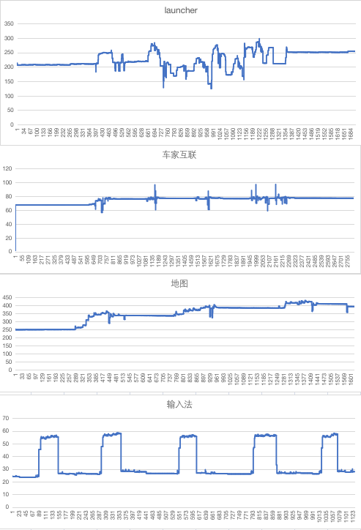
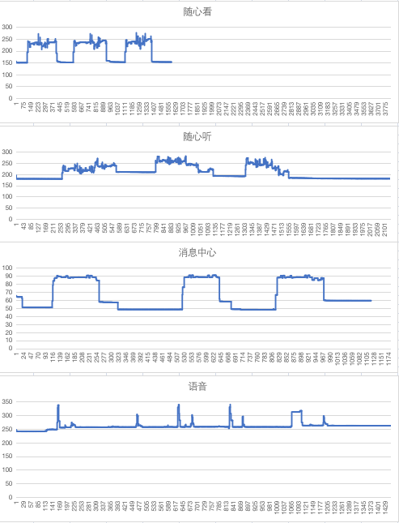
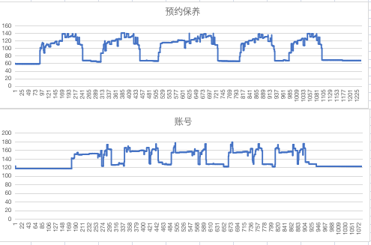
{P702_ R08} 内存泄漏专项测试

Slide 5
{P702_ R08} 语音专项测试
唤醒词唤醒率： Pass
唤醒词唤醒率
AI能力 | 指标项 | 通过标准 | 实测结果 | 测试结论
小度小度 | 低噪 | 92% | 100% | PASS
 | 中噪 | 90% | 99% | PASS
 | 高噪 | 85% | 98% | PASS
你好福特 | 低噪 | 92% | 100% | PASS
 | 中噪 | 90% | 100% | PASS
 | 高噪 | 85% | 99% | PASS
场景化命令词识别率
AI能力 | 指标项 | 通过标准 | 实测结果 | 测试结论
暂停播放 | 低噪 | 85% | 100% | PASS
 | 中噪 | 85% | 99% | PASS
 | 高噪 | 80% | 95% | PASS
继续播放 | 低噪 | 85% | 100% | PASS
 | 中噪 | 85% | 100% | PASS
 | 高噪 | 80% | 100% | PASS
上一首 | 低噪 | 85% | 99% | PASS
 | 中噪 | 85% | 98% | PASS
 | 高噪 | 80% | 100% | PASS
上一曲 | 低噪 | 85% | 96% | PASS
 | 中噪 | 85% | 96% | PASS
 | 高噪 | 80% | 88% | PASS
下一首 | 低噪 | 85% | 90% | PASS
 | 中噪 | 85% | 94% | PASS
 | 高噪 | 80% | 89% | PASS
下一曲 | 低噪 | 85% | 96% | PASS
 | 中噪 | 85% | 95% | PASS
 | 高噪 | 80% | 96% | PASS
接听电话 | 低噪 | 85% | 100% | PASS
 | 中噪 | 85% | 99% | PASS
 | 高噪 | 84% | 98% | PASS
挂断电话 | 低噪 | 84% | 99% | PASS
 | 中噪 | 84% | 100% | PASS
 | 高噪 | 84% | 98% | PASS
场景化命令词识别率
AI能力 | 指标项 | 通过标准 | 实测结果 | 测试结论
跟随模式 | 低噪 | 85% | 100% | PASS
 | 中噪 | 85% | 100% | PASS
 | 高噪 | 80% | 98% | PASS
车头朝上 | 低噪 | 85% | 100% | PASS
 | 中噪 | 85% | 99% | PASS
 | 高噪 | 80% | 95% | PASS
正北模式 | 低噪 | 85% | 99% | PASS
 | 中噪 | 85% | 96% | PASS
 | 高噪 | 80% | 96% | PASS
放大地图 | 低噪 | 85% | 100% | PASS
 | 中噪 | 85% | 98% | PASS
 | 高噪 | 80% | 98% | PASS
缩小地图 | 低噪 | 85% | 100% | PASS
 | 中噪 | 85% | 100% | PASS
 | 高噪 | 80% | 99% | PASS
打开路况 | 低噪 | 85% | 100% | PASS
 | 中噪 | 85% | 100% | PASS
 | 高噪 | 80% | 99% | PASS
关闭路况 | 低噪 | 85% | 99% | PASS
 | 中噪 | 85% | 100% | PASS
 | 高噪 | 80% | 100% | PASS
开始导航 | 低噪 | 85% | 100% | PASS
 | 中噪 | 85% | 95% | PASS
 | 高噪 | 80% | 90% | PASS
场景化命令词识别率
AI能力 | 指标项 | 通过标准 | 实测结果 | 测试结论
查看全程 | 低噪 | 85% | 100% | PASS
 | 中噪 | 85% | 100% | PASS
 | 高噪 | 80% | 98% | PASS
继续导航 | 低噪 | 85% | 99% | PASS
 | 中噪 | 85% | 100% | PASS
 | 高噪 | 80% | 98% | PASS
上一页 | 低噪 | 85% | 98% | PASS
 | 中噪 | 85% | 95% | PASS
 | 高噪 | 80% | 89% | PASS
下一页 | 低噪 | 85% | 100% | PASS
 | 中噪 | 85% | 100% | PASS
 | 高噪 | 80% | 95% | PASS
确定 | 低噪 | 85% | 100% | PASS
 | 中噪 | 85% | 96% | PASS
 | 高噪 | 80% | 91% | PASS
取消 | 低噪 | 85% | 100% | PASS
 | 中噪 | 85% | 98% | PASS
 | 高噪 | 80% | 100% | PASS
第一个 | 低噪 | 85% | 100% | PASS
 | 中噪 | 85% | 94% | PASS
 | 高噪 | 80% | 99% | PASS
第二个 | 低噪 | 85% | 100% | PASS
 | 中噪 | 85% | 100% | PASS
 | 高噪 | 80% | 100% | PASS
第三个 | 低噪 | 85% | 99% | PASS
 | 中噪 | 85% | 100% | PASS
 | 高噪 | 80% | 99% | PASS

Slide 6
{P702_ R08 HF2} 语音专项测试
误唤醒测试：Pass
AI能力 | 测试时长 | 通过标准 | 实测结果 | 测试结论
小度小度 | 静态测试 （互相聊天对话） 12小时 | <0.3次/h | 0 | PASS
你好福特 |  | <1.2次/h | 0 | PASS
小度小度 | 播放爱情公寓5 20小时 | <0.3次/h | 0 | PASS
你好福特 |  | <1.2次/h | 0 | PASS

Slide 7

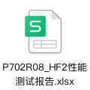
{P702_ R08} 性能测试
性能测试：Pass
稳定性及性能 | 指标项 | 通过标准 | 实测结果 | 测试结论
版本性能 | 流畅度 | 无卡顿 | 无卡顿 | Pass
 | Cpu | NA | 见性能测试sheet | NA
 | 内存 | NA | 见性能测试sheet | NA

